Slide 1

What do the terms ‘saving’ and ‘investment’ mean to an economist? → how interest rates are determined in the long-term
ECON 1BB3 – Introduction to Macroeconomics
Notes:
Investment = purchases of new physical capital (machineries, equipment, building, etc.). Does NOT refer to purchasing stocks and bonds

Slide 2
Financial institutions in Canada can be grouped into two categories:
1) Financial markets (directly link borrowers and savers)
  bond market
    loans that pay interest until the loan matures
    issued by large businesses, federal and provincial governments
    two characteristics of bonds influence the interest rate paid: term and credit risk
    the interest rate is greater if there is a higher risk and longer term for the bond
Notes:
Financial markets. There are two financial markets:
a) Bond market – involves loans. When you buy a bond you are making a loan to a company or government.
Large companies and governments issue bonds to people so they have to pay interest. The rate of interest depends on the term (length of the loan; the higher the term, the higher the interest rate → putting money in longer), and the risk (higher risk bonds, pay a higher interest rate; you have to be compensated to accept the higher risk).
-----------------------------------
→ Bring borrowers and savers directly into contact with one another
Bond market and Stock market
When you buy a bond it is issued by a government/large corporation is like making a loan. You will make interest from it.
Term = length of the loan; if loaning for a period of hours instead of for years (longer term = higher interest rate)
Risk = riskier year bond = higher interest rate
Bonds issued by Kazaskstan riskier than bonds issued by US

Slide 3
  stock market
    represents ownership in a firm
    individuals buy because there is profit (dividends) or capital gain
    there is also a risk of capital loss
    the return on stocks is greater than bonds because:
      riskier
      bankruptcy laws (
Notes:
b) Stock market – purchasing part ownership of the firm. When the firm makes profits, you get share of that profit (this is called dividend).
Want to own a part of the firm in hopes of making a capital gain (i.e. you pay $5 for the stock and sell it for $10). The value of the stock can go up and down depending on supply and demand.
Because there is an opportunity for capital gain in stocks, there is also a risk of capital loss.
Return on stocks is higher than the return on bonds b/c of two reasons:
1. stocks are risker b/c of potential for capital loss
2. bankruptcy laws b/c if a company goes bankrupt, bond holders get paid off with the companies remaining assets before stock holders
Unlike a bond, when purchase a stock, you are buying partial ownership of the company. You will hopefully get a share of the profits (dividend). You may also get capital gain.
Capital gain = also have potential for capital losses (i.e. happened for a lot of people in the last six months).
Stock market has very high risk.
Bonds are safer assets. Dividends you get paid cash. Buy a bond with a stock broker.
Risk is rewarded with higher rate of return

Slide 4
2) Financial intermediaries (Indirect link between savers and borrowers)
  banks
    provide loans to smaller companies, banks, and households
    primary objective is to take in deposits from savers and lend to borrowers
  mutual funds
    allow people with small amounts of money to buy stocks together
Notes:
Saving and borrowing related to banks.
2) Financial Intermediaries
-Banks: provide loans and take deposits from savers.
-Mutual funds: takes money from people with small amounts who are interested in buying stocks and bonds ; pool all the money and purchase stocks and bonds issued by individual companies.
-------------------------------------
Financial intermediaries are between savers and spenders. They provide loans to households and small businesses.
Big banks → difference of what they pay
2) Mutual fund → takes $100/mnth from one person, $100/mnth from another person until all reach 10000000 and then purchase stock together.
Index fund is like a mutual fund, except no manager that is picking out the stocks. Increase go up, make money; if not, lose money

Slide 5
Saving and investment
    National income accounting identity:
    Y = C + I + G
Notes:
NIAI = no net exports b/c looking at saving and investment in a closed economy.
Saving vs. investment → when buy share of toyota…allocating savings in the market. The decision to buy a stock is not an investment. Buying a car to open up a limo business is an investment. Buying stocks and bonds = savings

Slide 6
Saving and investment
  private saving: S_{p}
  private saving: is the income leftover after paying for taxes and consumption
  public saving: S_{g}
  public saving: is the amount of tax revenue that the government has left after paying for spending
  if T> G, there is a budget surplus
  If T < G, there is a budget deficit
= Y
– T
– C
= T
– G
Notes:
Private saving = S(p) = saving by households.
Public saving = S(g) = saving by governments.
With every pay check in Canada, the government is the first to take money away. With what’s left, you can either save it or spend it.
Definition of private saving is therefore: income – taxes – consumption
Definition of public saving is saving from the perspective of the government; their income is from the government, outflows are government spending: taxes – government spending
There is a budget surplus if T > G; budget deficit if T < G
Canada has been running budget surpluses for the past 10-15 years. Canada about to run budget deficit. US running budget deficit for the past 8 years.
-------------------------------------------------------------------
Y = income
T = taxes (government)
C = consumption.
Public saving = saving on the part of the government. From the government perspective, they are taking our tax dollars.
Government budget surplus = tax rev > spending
Government budget deficit = tax rev < spending
We’re about to have a deficit
US has a HUGE deficit → spent a lot on the war. Cut taxes = stupid!

Slide 7
National Income
Accounting Identity:
Definition of Saving:
Y = C + I + G
S = S_{p} + S_{g}
Y – C – G = I
S_{p} = Y – T – C
S = I
S_{g} = T – G
S = Y – T – C + T – G
S = Y – C – G
Notes:
National Saving = S
The key finding of chapter 8. In a closed economy, national saving = national investment.
More saving = more investment.

Slide 8
Market for loanable funds - madeup
  Slope; shift factors
  demand
    negative slope
    ONLY firms must borrow to invest (purchase of machinary, capital, etc, NOT stocks/bonds – use savings to buy it)
      Assume households do not borrow to invest in a car
    interest rate , borrowing to invest becomes more expensive
      IR is the cost of investment
Notes:
Market model for market for loanable funds. This includes a demand curve and a supply curve. Assume that demand for LF comes from firms only who want to borrow in order to invest. Supply comes from households and governments only. Going to see how those savings and borrowing decisions related to the interest rate.
Important to understand why the slopes are the way that they are and why they shift. That way we can use it to analyze different questions.
Demand curve – comes from firms who want to borrow to invest. It has a –ve slope b/c as interest rates rise, borrowing becomes expensive and therefore firms invest less.
----------------------------------------
First assumption that all saving in the economy come from household and government (pretend that businesses never save, always spend; all investment come from firm). This is unrealisitic, but using the model is easier. → model determines what interest rate should be in the long term
Firms are borrowing in order to buy goods, build a new factory. So when interest rate goes up , quantity of loanable funds is different. …see next slide
Increase rate up = investment down = negative slope
Supply curve and demand curve come from household/government. If interest rate goes up gets more income.
We can consume now or later. Save now to consume later. When interest increases, get more consumption
Also assume

Slide 9
Market for loanable funds
  supply
    positive slope
    for households, when the interest rate every dollar saved now allows = more future consumption
    public saving does not depend on the interest rate
Notes:
Supply curve - +ve slope comes from households. Households decide to consume now or consume later. In order to consume later, we have to save. For every dollar saved now, if interest rate is higher that saved dollar allows for more future consumption than with a lower interest rate. When the interest rate goes up, have an incentive to save more.
Public saving does not depend on interest rate. Government makes tax decisions and government spending decisions independent of the interest rate.
r = interest rate
Q of LF = quantity of loanable funds
Write savings and investment in diagram too as a reminding as to what causes the curve to shift. Saving comes from household and governments and investment comes from firms.
There are three types of shocks with this model!

Slide 10

ECON 1BB3 – Introduction to Macroeconomics
Notes:
Friday 13, 2009
7,8,9 → how economy functions in long run

Slide 11
Review
  Demand
  there is a negative relationship between investment and the interest rate
  Supply
  there is a positive relationship between saving and the interest rate
Notes:
Demand for market of loanable funds has a negative relationship b/w investment and interest rate

Slide 12
Review
r
S (saving)
Sp + Sg
r1(1)
I
D (investment)
I(1) = S(1)
Q of LF
Notes:
In the equilibrium graph, when S = D, the curve also depicts that saving = investment; interest rate adjusts to bring saving in line with investment
Q of Loanable Funds (measured In dollars)
Savings and investments are FLOW varibles
-→ The negative slope exists even if a company does not have to borrow, why is interest rate still relevant? Because it is the OC of investing. You can loan it to someone else and earn IR rather then have the money sit at home.

Slide 13
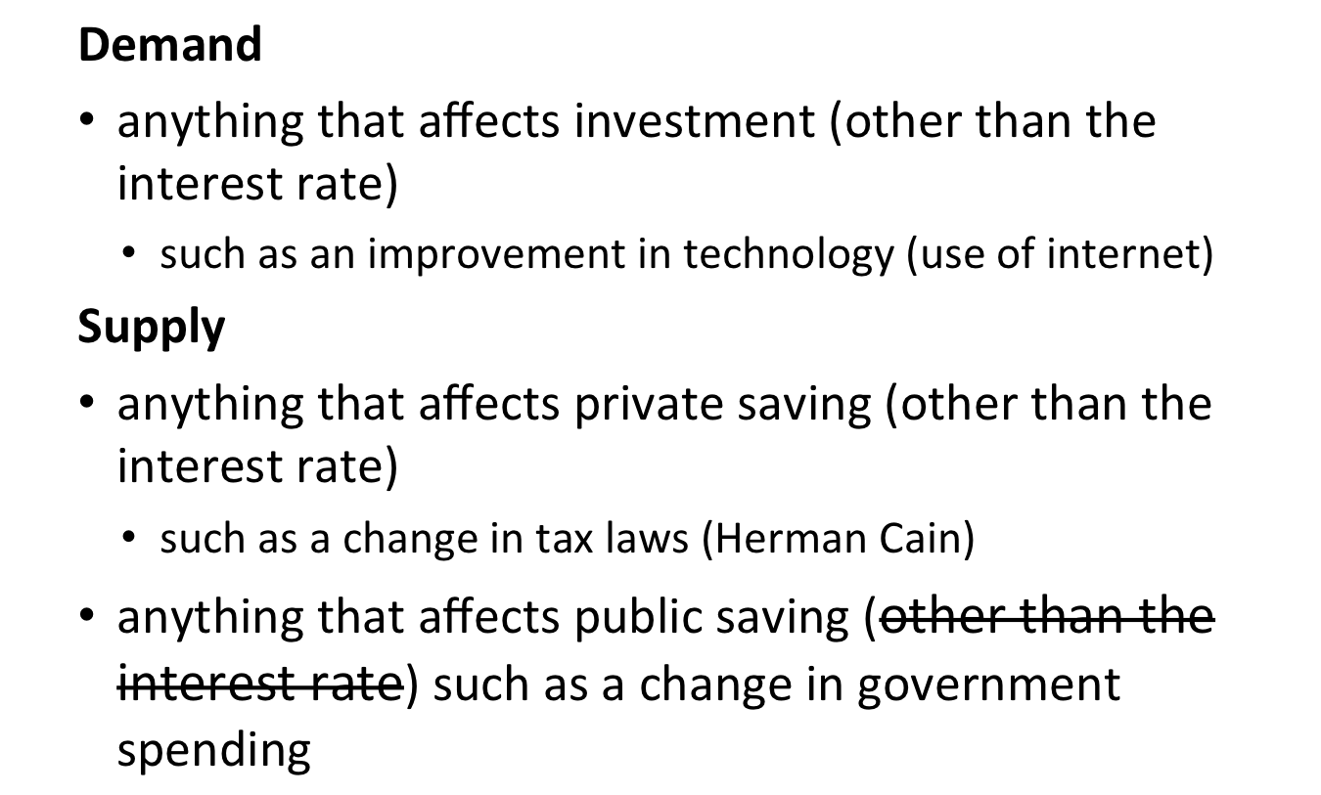
Shift factors
Notes:
Vertical axis varialbe MOVES ALONG the curve (anything other than the interest rate will shift the curve)
Example for demand bullet:
If government introduced an investment tax credit, then firms get a tax credit when they invest, giving them an incentive to invest more at every interest rate and the demand curve would shift out to the right
Supply:
Example: going from an income tax to consumption tax
--------------------------------------------
→ Entire demand curve shifts out to the right
If company invests, they get a tax break. Demand shifts right (INVESTMENT TAX CREDIT). If it is removed, demand shifts left (decrease investment spending)
Change in interest rate only affects government spending
Tax-free savings account (RRSP, RESP → getting people to save more). Increase in household saving
Interest does NOT affect public saving
other than the interest rate
Herman Cain 9-9-9 (throw the tax at the federal lvl, 9% corporate income, 9% income tax, and 9% federal sales tax)
→ Lowering income tax, raise sales tax (more savings, so Sp goes up)

Slide 14
Comparative statics examples
In the following cases, use a market diagram to show what happens to the demand and/or supply curves.
What happens to the interest rate, investment, national saving, private saving, and public saving?

Slide 15
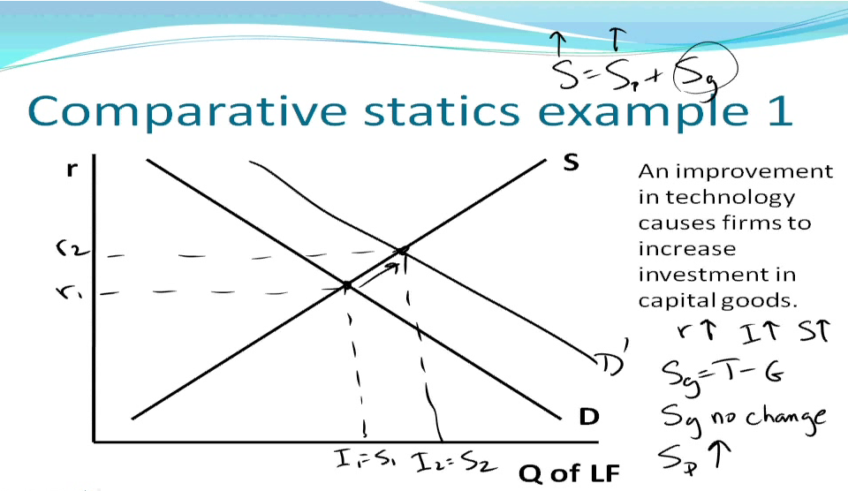
Comparative statics example 1
r
S
An improvement in technology causes firms to increase investment in capital goods
r1
D
I1 = S1
Q of LF
Notes:
r1 = interest rate
Q1 =(I1 = S1) – reminder that quantity of loanable funds at eqm is equal to investment and national saving
Improvement in tech, increase investment, causing demand curve to shift out to the right → interest rate increases to r2 and saving and investment increase too
Remember that S(national saving) = S(public) + S(private)
Public saving = taxes – government spending;
- in this example, there were no changes in taxes and not change in gov spending…meaning that there is no change in public saving
Private saving
In this example, must have gone up since there was no change in public saving and national saving increased
Private saving increases b/c interest rate increases; when interest rate is higher, households want to save more (every dollar they save now, gets them more future interest income)
----------------------------------------------------
Investment is a flow variable. GDP is a flow variable and investment is part of it (it is within a given period of time).
Demand increases
R increases, I increases, S increases, Sp increases, Sg no change
Sp = private saving
Sg = public saving
S = Sp + Sg
Sg = T – G

Slide 16
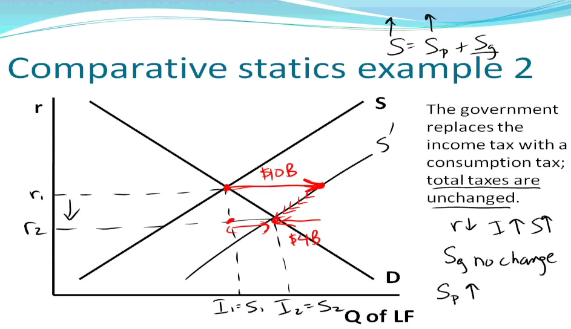
Comparative statics example 2
Notes:
Government replaces consumption tax with income tax, but total tax is unchanged. This affects households. Nothing happens to government spending, meaning that public saving will not change. When have consumption tax, consuming is more expensive so people are more likely going to save a larger portion of their income. Supply curve will shift out right; interest rate decreases, investment and national saving increases.
Because taxes don’t change and government spending doesn’t change, public saving stays the same. Private saving must increase since national saving increased. BUT – the interest rate decreased (but we know that private saving is +vely related to the interest rate, so when interest rate, private saving should increase and vice versa). This is contradictory! How do we tell?
This was a response Households save more due to the increase in private saving in response to a change in the way taxes were collected. O.o
This means that…
At every interest rate, households save more (then increase saving by 10 billion dollars) but initially the quantity of loanable funds supplied is greater than the quantity of loanable funds demande (so firms only want to invest the same amount that they originally wanted to invest in; households are saving more). The only way to encourage firms to borrow some of this new saving is only if the interest rate decreases. As interest rate decreases, private saving decreases a little bit (i.e. pull back by 4 bil, still leaving a net increase of 6 bil). THUS private saving increased, but it hasn’t increased as much as the initial horizontal shift.
-------------------------------
No longer have income tax but GST and PST is now 85%. Households are affected immediately
Change in tax policy that leaves total taxes unchanged. People now taxed on what they consume.
R decreases, I incerased, S increases.
Sg = no change
Sp =increases
First cases interest rate increases, you want to save more.

Slide 17
Comparative statics example 3
r
S
The government increases spending
D
Q of LF
Notes:
Government increases spending, holding taxes constant → meaning that public saving decreases and supply curve shifts left. Interest rate increases to r2 and national saving & investment decreases. Private saving increases b/c interest rate increases; public saving decreases…how?
Public saving decreases (causing the shift) and national saving decreases (as move from s1 to s2). Private saving increases b/c interest rate is higher. This holds true as long as increase in private saving is smaller than decrease in public saving.
Similar to prev example:
Initial decrease that causes curve to shift (big black arrow). But at initial interest rate, quantity demanded > quantity supplied, meaning that firms will want to invest a lot, but government has pulled back at supply of savings into market of loanable funds (upward pressure on interest rate; as interest rate increases → households start to save more). This means that household saving increases and public saving decreases.
Private investment decreases = crowding out (when increase in government spending causes private investment to decrease aka private investment has been crowded out by increase in government spending)
Do each example in reverse (i.e. rather than government increase spending, holding taxes constant → ask what happens when governments decrease spending, holding taxes constant
-----------------------------
If G increases, SD increase
R Increases, I decreases,. S decreases Sp increases Sg decreases,
As poepl e]
Government deficiet buy for company in

